Slide 1
Bagging VS. Boosting
Marlabs

Slide 2
Bagging and Boosting are similar in that they are both ensemble techniques
Ensemble Method: a set of weak learners are combined to create a strong learner that obtains better performance than a single one.

Slide 3
Bagging(bootstrap aggregating)
Bagging is a simple ensemble technique in which we build many independent predictors/models/learners and combine them using some model averaging techniques. (e.g. weighted average, majority vote or normal average)
Take random sub-sample/bootstrap of data for each model. Each observation is chosen with replacement to be used as input for each of the model. Because this technique takes many uncorrelated learners to make a final model, it reduces error by reducing variance. Example of bagging ensemble is Random Forest models.

Slide 4
Differences between Random Forest and Boosting?
error = bias + variance + (random error)
Boosting is based on weak learners (high bias, low variance). In terms of decision trees, weak learners are shallow trees, sometimes even as small as decision stumps (trees with two leaves). Boosting reduces error mainly by reducing bias (and also to some extent variance, by aggregating the output from many models).
Random Forest uses fully grown decision trees (low bias, high variance). It reduces error by reducing variance. The trees are made uncorrelated to maximize the decrease in variance, but the algorithm cannot reduce bias (which is slightly higher than the bias of an individual tree in the forest). Hence the need for large, unpruned trees, so that the bias is initially as low as possible.

Slide 5
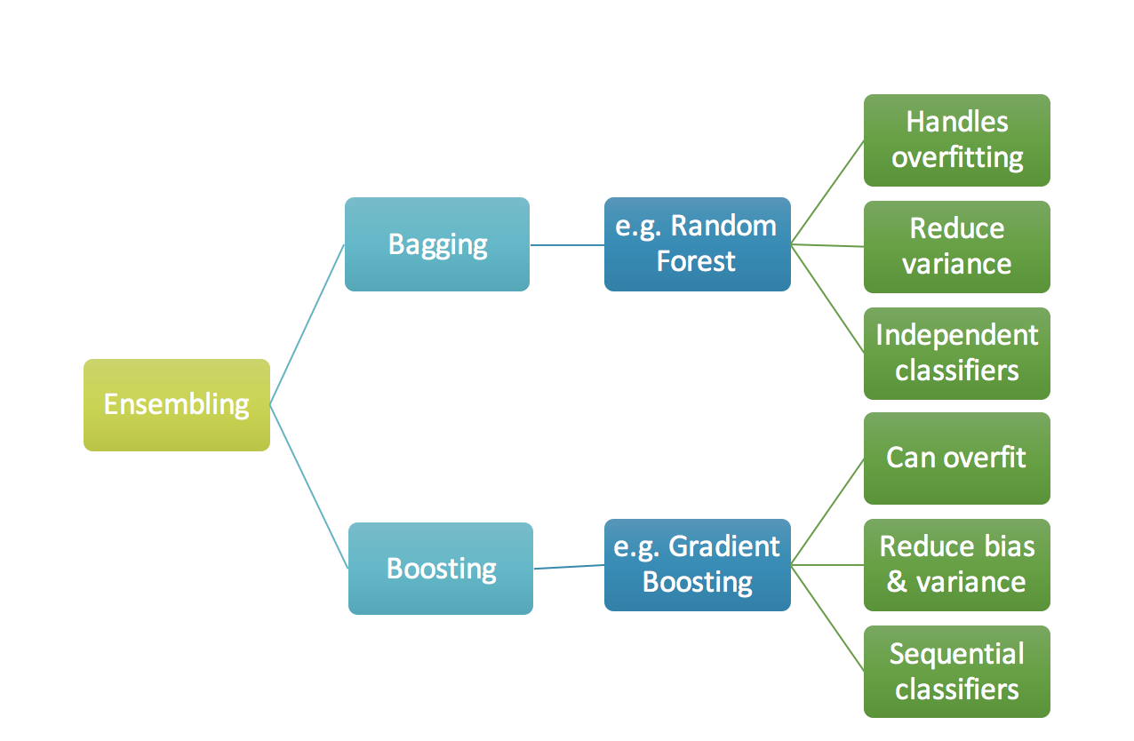

Slide 6
